Slide 1
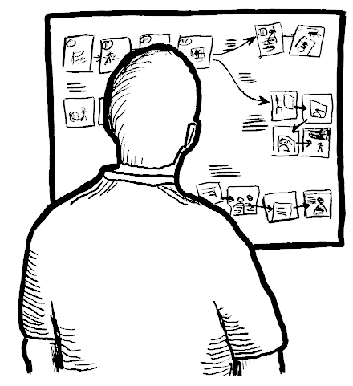
The State Transition Diagram
Chapter 4.2 in Sketching the User Interface: The Workbook
Image from:

Slide 2
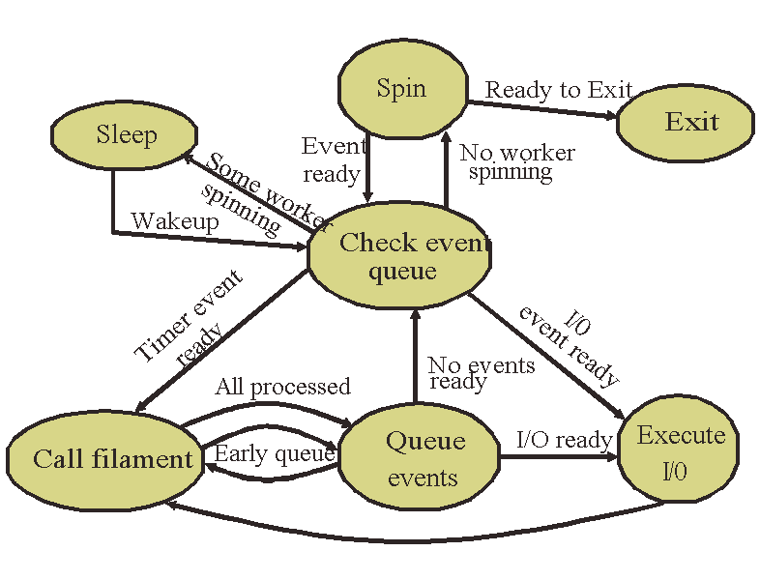
As You Descend the Design Funnel…
Storyboard
  more keyframes
  finer-grained transitions
  Decision paths
    multiple transitions (options) a user can pursue
    or design alternatives
    lead to different sequences
State transition diagrams do
the same thing!
Image from: Anderson et. Al. Buttress. Usenix Fast ‘04

Slide 3
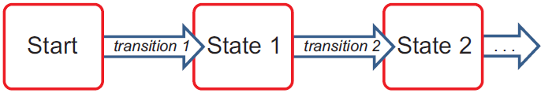
State Transition Diagrams
Captures
  states – a moment in time
  transitions – trigger that causes change in state
  paths – prescribed sequence(s) through states

Slide 4
The Abstract Diagram
Captures
  flow of user activities as abstractions
  no visual details but
  easy to modify

Slide 5
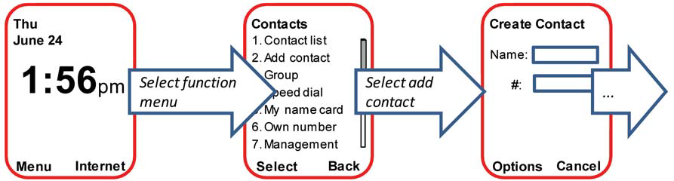
The Visual Interface Diagram
Captures
  appearance as it passes through each state
  good for details
  harder to modify

Slide 6
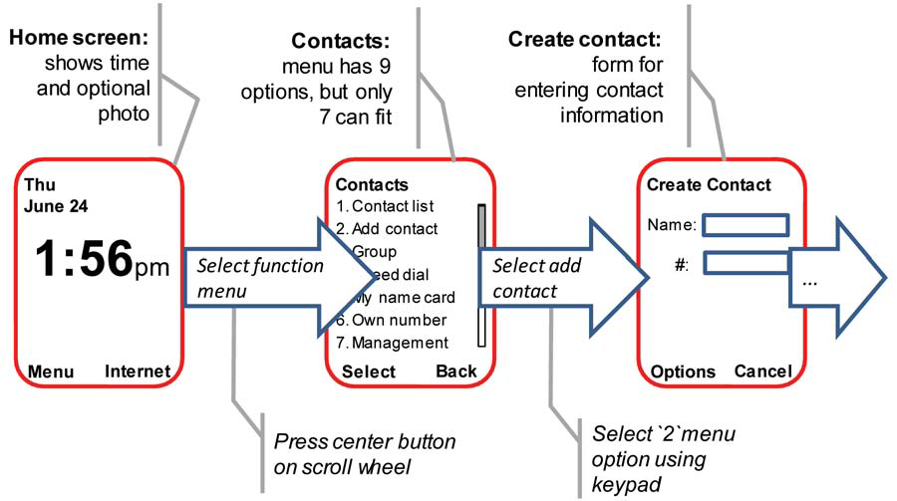
The Annotated Diagram
Augmented to include explanatory text

Slide 7
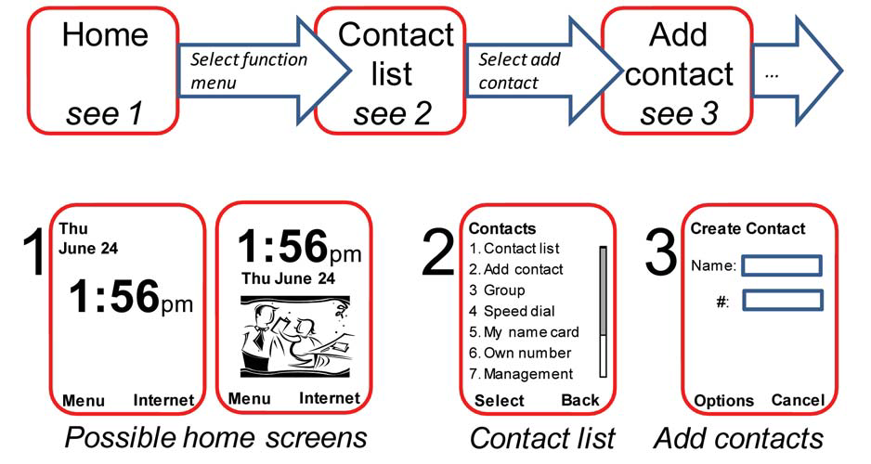
The Indexed Diagram
To manage complexity and multiple possibilities

Slide 8
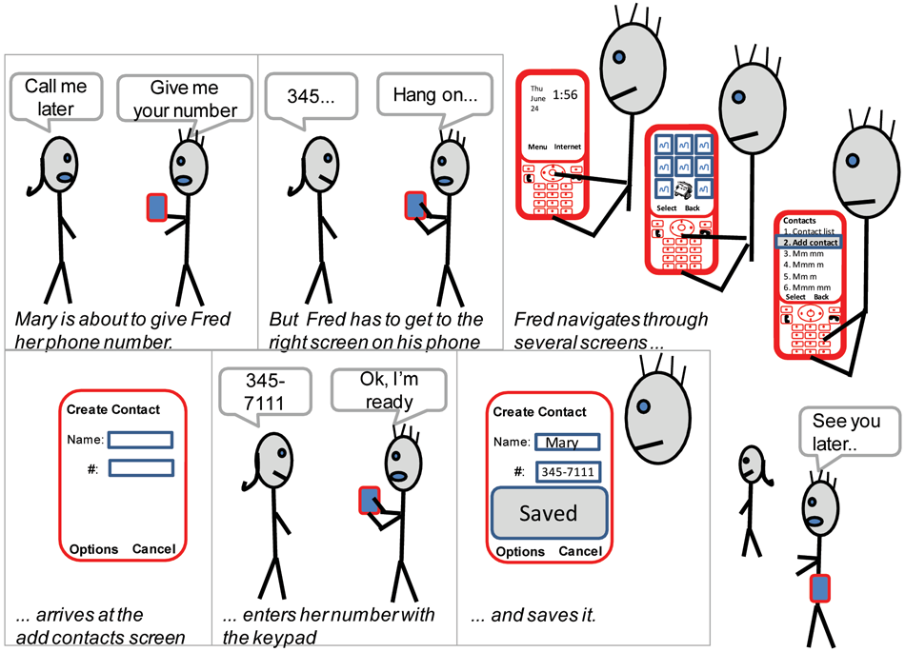
Using Layout to Imply State

Slide 9
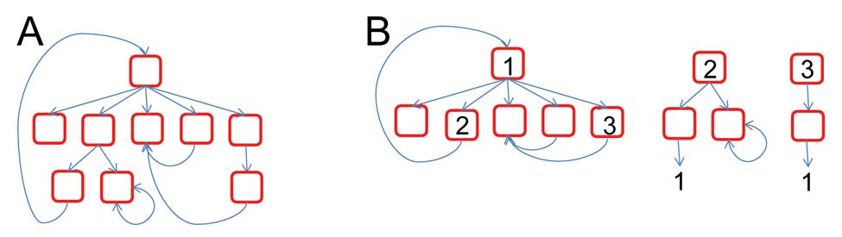
Branching
Most interfaces contain decision paths
  multiple transitions
These diagrams are
identical

Slide 10
Exercise
Your digital (or cell phone)
Construct state transition diagrams to
  capture a simple sequential operation
  illustrate each of the above techniques
Image from:

Slide 11
Preview: Branching
Most interfaces contain decision paths
  multiple transitions
These diagrams
are identical

Slide 12
You Now Know
State transition diagrams capture
  State
  transitions
  decision paths
Many ways to draw them
    abstract
    visual interface
    annotated
    indexed (to manage complexity)
    implied by spatial layout
    with branches (more to come on this topic)

Slide 13



Permissions
You are free:
  to Share — to copy, distribute and transmit the work
  to Remix — to adapt the work
Under the following conditions:
Attribution — You must attribute the work in the manner specified by the author (but not in any way that suggests that they endorse you or your use of the work) by citing:
  “from presentations accompanying the book ‘Sketching User Experiences, the Workbook’, by S. Greenberg, S. Carpendale, N. Marquardt and B. Buxton”
Noncommercial — You may not use this work for commercial purposes, except to assist one’s own teaching and training within commercial organizations.
Share Alike — If you alter, transform, or build upon this work, you may distribute the resulting work only under the same or similar license to this one.
With the understanding that:
Not all material have transferable rights — materials from other sources which are included here are cited
Waiver — Any of the above conditions can be waived if you get permission from the copyright holder.
Public Domain — Where the work or any of its elements is in the public domain under applicable law, that status is in no way affected by the license.
Other Rights — In no way are any of the following rights affected by the license:
  Your fair dealing or fair use rights, or other applicable copyright exceptions and limitations;
  The author's moral rights;
  Rights other persons may have either in the work itself or in how the work is used, such as publicity or privacy rights.
Notice — For any reuse or distribution, you must make clear to others the license terms of this work. The best way to do this is with a link to this web page.

